Slide 1
The meeting teleconference will begin shortly
Listen to the meeting by using your computer or tablet speakers
or by calling (877) 853-5247 using meeting ID 684-456-030
View the live meeting presentation at https://sbvmwd.zoom.us/j/684456030
Public comments, suggestions or questions regarding technical issues may be emailed to comments@sbvmwd.com
Please use the chat feature in the Zoom toolbar to let the moderator
know that you would like to make a comment during the meeting or use the digital “raise hand” function in Zoom.
Please mute your microphone during the meeting to reduce background noise. Click on the microphone icon to unmute your microphone if needed.

Slide 2
NOTICE REGARDING (COVID-19)
Before we begin, the record will reflect that pursuant to the provisions of Executive Order N-29-20 issued by Governor Gavin Newsom on March 19, 2020, this meeting will be conducted by teleconference only.
Please note that all actions taken by the Board during today’s meeting will be conducted by a roll call vote.

Slide 3
Call to Order
Regular Meeting of the Board of Directors
Tuesday, October 6, 2020

Slide 4
Pledge of Allegiance

Slide 5
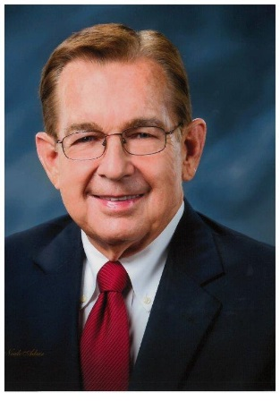
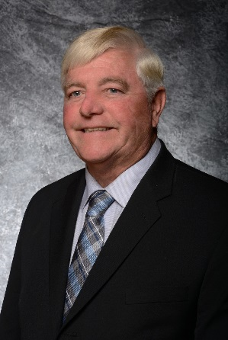
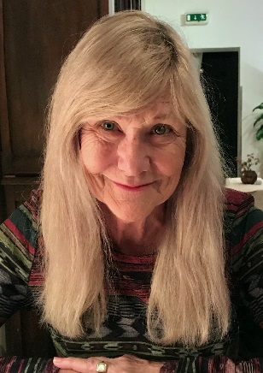
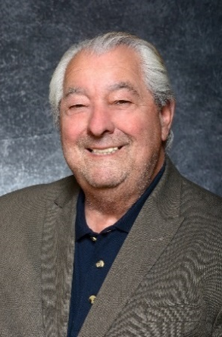
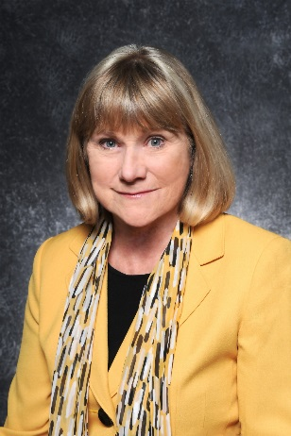
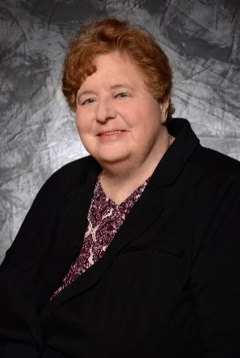
Roll Call
T. Milford
Harrison
President
Paul Kielhold
Vice President
Susan Longville
Treasurer
June Hayes
Director
Gil Navarro
Director

Slide 6
Public Comment
Any person may address the Board on matters within its jurisdiction.
* Please use the chat feature on the Zoom toolbar or digitally raise your hand to let the moderator know you would like to make a comment.

Slide 7
Approval of Minutes (Pg. 4)
Regular Board Meeting – September 15, 2020

Slide 8
Board Motion & Roll Call Vote
Staff Recommendation
To approve the minutes of the September 15, 2020, Regular Meeting of the Board of Directors as presented.
T. Milford
Harrison
President
Paul Kielhold
Vice President
Susan Longville
Treasurer
June Hayes
Director
Gil Navarro
Director

Slide 9
Discussion Item 3.1 (Pg. 10)
Matt Howard, MS – Water Resources Senior Project Manager
Chris Jones, MESM – Project Manager II, Biological Resources
Consider Resolution No. 1107 Adopting the Santa Ana Watershed Project Authority One Water One Watershed (OWOW) Plan Update 2018
Staff Recommendation
Staff recommends that the Board approve Resolution No. 1107 formally adopting the 2018 Update to the One Water One Watershed Integrated Regional Watershed Management Plan.

Slide 10
Adopting the OWOW Plan Update 2018
SAWPA along with its Member Agencies, Stakeholders and partners in the Santa Ana River Watershed prepared the One Water One Watershed (OWOW) Plan Update 2018, the Integrated Regional Water Management (IRWM) Plan for entire Santa Ana River Watershed.
Valley District was selected to receive $2 million for its Evans Lake Tributary Restoration and Camp Evans Recreation project, which is a habitat restoration project located in the City of Riverside being completed on behalf of the Upper Santa Ana River HCP
To help simplify the submittal of the overall grant application to DWR, SAWPA has asked that each of the agencies that were awarded grant funds to adopt the OWOW Plan Update 2018 including the finalized list of projects.

Slide 11
Board Motion & Roll Call Vote
Staff Recommendation
Staff recommends that the Board approve
Resolution No. 1107 formally adopting the 2018 Update to the One Water One Watershed Integrated Regional Watershed Management Plan.
T. Milford
Harrison
President
Paul Kielhold
Vice President
Susan Longville
Treasurer
June Hayes
Director
Gil Navarro
Director

Slide 12
Discussion Item 3.2 (Pg. 16)
Bob Tincher, PE, MS – Chief Water Resources Officer/Deputy General Manager
Consider Resolution No. 1108 Approving Amendment No. 18 to the SBVMWD State Water Project Contract to Provide Management Flexibility and Making Findings Pursuant to the California Environmental Quality Act
Staff Recommendation
Staff recommends that the Board approve Resolution No. 1108 which 1) authorizes Amendment No. 18 to the Valley District State Water Project (SWP) Contract; and, 2) as a Responsible Agency makes findings pursuant to the California Environmental Quality Act (CEQA); and, 3) adopts CEQA findings and statement of overriding considerations.

Slide 13
Background
June 2018
Agreement in Principle (AIP) reached
October 2018
EIR circulated
May 2019
Project approval withdrawn for CA WaterFix
Agreement by DWR and PWAs to remove CA WaterFix cost allocation sections from the AIP
August 2020
Project Approval and NOD
EIR amended and recirculated

Slide 14
What the Contract Amendments do:
Exchanges (amendments to Article 56)
Clarify existing practice
Multi-Year Transfers (Article 57)
Add new flexibility and tools for single and multi-year transfers
Existing DWR review and approval remains

Slide 15
Exchanges
Amend Article 56 to:
Confirm exchange provisions for water exchanges between Public Water Agencies (PWAs)
Set exchange ratios based on water allocation, up to 5 to 1
Set the maximum cost compensation for an exchange
Allow the exchange to be effectuated over ten years

Slide 16
Transfers
Adds a new article 57 that:
Creates new flexibility for non-permanent transfers (DOES NOT APPLY)
Removes the turnback pool as the only non-permanent transfer mechanism (DOES NOT APPLY)
Allows the PWAs to set the compensation terms (DOES NOT APPLY)
Requires certain conditions be met to avoid harm to SWP operations and other contractors
Continues to require DWR approval
Amends article 21 to:
Allow for limited ability to transfer article 21 water consistent with other transfer rules.

Slide 17
Other Provisions
Allows for groundwater stored outside a PWA’s service area to be transferred or exchanged without first returning to the PWA’s service area
Allows up to 50% of certain PWA carryover stored in San Luis Reservoir to be transferred or exchanged
Adds provisions to provide transparency
Adds a dispute resolution process if a PWA claims a transfer or exchange will cause them harm

Slide 18
Effective Date
Effective when 24 PWAs sign the contract amendment
If 24 PWAs have not signed by February 28, 2020, DWR may allow the amendment to be effective for those PWAs who have signed

Slide 19
Board Motion & Roll Call Vote
Staff Recommendation
Staff recommends that the Board approve Resolution No. 1108 which 1) authorizes Amendment No. 18 to the Valley District State Water Project (SWP) Contract; and, 2) as a Responsible Agency makes findings pursuant to the California Environmental Quality Act (CEQA); and, 3) adopts CEQA findings and statement of overriding considerations.
T. Milford
Harrison
President
Paul Kielhold
Vice President
Susan Longville
Treasurer
June Hayes
Director
Gil Navarro
Director

Slide 20
Discussion Item 3.3 (Pg. 66)
Chris Jones, MESM – Project Manager II, Biological Resources
Consider Amendment Thirteen to the ICF Jones & Stokes Consulting Agreement for Inclusion of Evans Lake Tributary Project and Extension of Agreement Period
Staff Recommendation
Staff recommends the Board direct staff to authorize the CEO/General Manager to execute Amendment 13 to the ICF Jones & Stokes Consulting Agreement for inclusion of design, CEQA compliance, and regulatory assistance associated with the Evans Creek Project and extension of contract duration for an additional two years on behalf of the HCP.

Slide 21
Evans Lake Tributary Restoration and Camp Evans Recreation Project Vicinity

Slide 22
Project Location

Slide 23
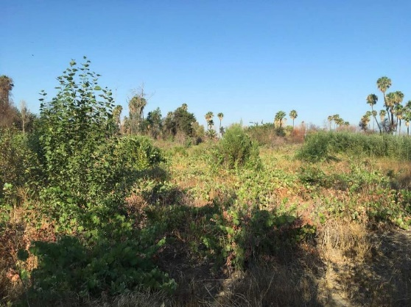
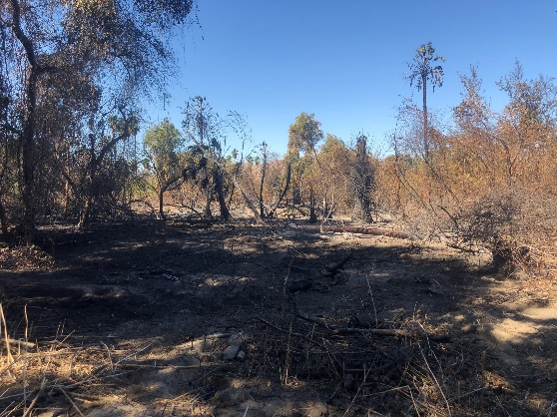
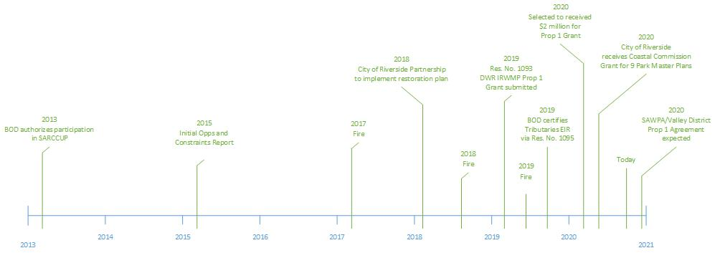
Evans Lake Tributary Restoration and Camp Evans Recreation Project Timeline
August 2, 2018
November 1, 2019

Slide 24
Conceptual Designs and Project Elements
Project Elements
Restoration
Aquatic
Riparian
Upland
Recreation
Wildlife Viewing
Trails
Challenge Course
Picnic
Scout Camping
Archery
Community Garden
Education
Nature Pavilion
Interpretive Signage

Slide 25
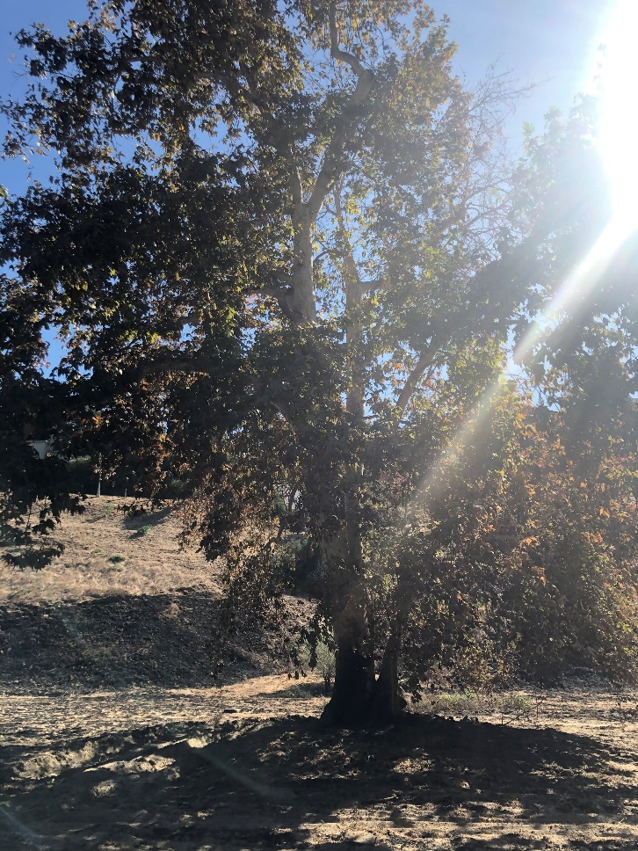
Amendment 13 Scope of Work
Task 1 Project Management
Task 2 Final Design
Field topography survey
Hydrology, Hydraulic and Sediment Transport Analysis
Tree Inventory
Basis of Design Report
30%, 60%, 90% and 100% Plans and Specifications
As-Built Drawings
Task 3 Bidding and Contractor Selection
Task 4 CEQA Compliance
Prepare Draft and Final EIR Addendum
Technical Evaluations: Cultural and Paleontological Resources
Task 5 Seed and Plant Material Procurement
Task 6 Permitting Support
Task 7 As-Needed Design Support
Coordination with City of Riverside designers
Task 8 ICF Internal Program Management
Increases Contract Duration for an Additional 2 Years

Slide 26
Fiscal Impact
Included in FY 2020/2021 Budget Line 6780
Subject to HCP Partner Cost Share
Cost will be applied to Prop 1 Grant match requirement
Cost Description | Dollars
Overall Cost for ICF Amendment 13 | $926,361.53
HCP Cost Paid By Funding Partners (60%) | $555,816.92
Valley District’s Cost (40%) | $370,544.61

Slide 27
Board Motion & Roll Call Vote
Staff Recommendation
Staff recommends the Board direct staff to authorize the
CEO/General Manager to execute Amendment 13 to the
ICF Jones & Stokes Consulting Agreement for inclusion of design, CEQA compliance, and regulatory assistance associated with the Evans Creek Project and extension of contract duration for an additional two years on behalf of the HCP.
T. Milford
Harrison
President
Paul Kielhold
Vice President
Susan Longville
Treasurer
June Hayes
Director
Gil Navarro
Director

Slide 28
Discussion Item 3.4 (Pg. 111)
Bob Tincher, PE, MS – Chief Water Resources Officer/Deputy General Manager
Consider New Coordinated Operating Agreement with Metropolitan Water District of Southern
California
Staff Recommendation
Approve the Coordinated Operating Agreement with the Metropolitan Water District of Southern California.

Slide 29
Stewardship
Over the years, the Board has desired to see its investment in the SWP utilized even when the Valley District service area cannot use the water, it is surplus
In 2017, the Board formalized this approach in Ordinance No. 79
Staff must prove that surplus water exists
The board must declare water surplus
Directs the General Manager to identify opportunities to sell surplus water

Slide 30
Background
2000 COA
2020 COA
Expired in 2016
Stayed litigation
Coordinated use of facilities
Built Foothill Pump Station for Valley District at MWDSC expense
Identify any new projects
Sale of Valley District surplus water (20,000 AFY min)
15,000 AF (75%) for EMWD, IEUA, OCWD and WMWD
Maximize benefits from Seven Oaks Dam
Mutual Aid
Does not expire unless SWCs expire
Coordinated use of facilities
Identify any new projects
Sale of Valley District surplus water
First 5,000 to SGPWA
50% to SARCCUP (EMWD, IEUA, OCWD, WMWD)
Supplemental stormwater capture
Mutual Aid

Slide 31
Benefits from 2000 COA
Metropolitan
Valley District
Conveyed over 600,000 AF through Foothill Pipeline to fill Diamond Valley Reservoir
Purchased 223,500 AF of Valley District surplus water
Received Foothill Pump Station
Used Inland Feeder to bypass Foothill Pipeline while re-routing around San Manuel Casino
Received about $21 million for surplus water sales
One-time participation in MWDSC central valley water bank (Kern-Delta)
Emergency pipe fabrication agreement

Slide 32
2020 COA Surplus Water Pricing
Goal: Price the water so the SARCCUP agencies do not have to pay MWDSC any additional fee through SARCCUP
Price paid to Valley District(negotiated every 5 years)
Final SWP Allocation
0 - 20% | $450
21 - 40% | $350
41 - 60% | $250
61 - 100% | $125
2000 COA
~$100/AF

Slide 33
Board Motion & Roll Call Vote
Staff Recommendation
Approve the Coordinated Operating Agreement with the Metropolitan Water District of Southern California.
T. Milford
Harrison
President
Paul Kielhold
Vice President
Susan Longville
Treasurer
June Hayes
Director
Gil Navarro
Director

Slide 34
Discussion Item 3.5 (Pg. 122)
Heather Dyer, MS, MBA – Chief Executive Officer/General Manager
Consider Board Position on Proposition 15: Schools and Communities First Ballot Initiative
Staff Recommendation
Discuss whether or not to take a formal position in support or opposition of Prop 15 and direct Staff accordingly.

Slide 35
Public Comment
From: James Albert Date: October 5, 2020 at 6:36:14 PM PDT To: comments <comments@sbvmwd.com> Subject: Public Comment Item #3.5
﻿
Hello,
I am a SBVMWD constituent and a big Prop 15 supporter. I hope you support this agenda item to give us a better chance at ensuring the campaign's success and we generate much needed revenue to fund our local services (i.e. water infrastructure). Thank you for your time and consideration. As elected officials, please consider endorsing our campaign by filling out the following form.
https://www.yes15.org/endorse-elected-public-officials
Sincerely,
James Albert
League of Women Voters of the San Bernardino Area
#YesOn15 Chapter Coordinator

Slide 36
Board Motion & Roll Call Vote
Staff Recommendation
Discuss whether or not to take a formal position in support or opposition of Prop 15 and direct Staff accordingly.
T. Milford
Harrison
President
Paul Kielhold
Vice President
Susan Longville
Treasurer
June Hayes
Director
Gil Navarro
Director

Slide 37
Discussion Item 3.6 (Pg. 172)
Wen Huang, PE, MS – Chief Engineer/Deputy General Manager
Consider Agreement between California Department of Parks and Recreation, San Bernardino Regional Water Resources Authority, Valley District, and the City of San Bernardino with respect to the Bryce E. Hanes Park
Staff Recommendation
It is recommended that the Board of Directors authorize the CEO/General Manager to execute Agreement between the parties subject to nonsubstantive edits suggested by the State Counsel and approved by House Counsel.

Slide 38
Summary of Timelines
August 5, 2020, the Board of Directors approved the Cooperative Agreement with the City of San Bernardino to terminate the JPA and provide financial assistance for transfer of the Hanes Park to the City.
August 10, 2020, the JPA Board approved the “Assignment” Agreement in its substantive form with the City of San Bernardino to transfer JPA obligations of the Park to the City.
State Dept of Parks and Recreation desires that the District execute the “Assignment” Agreement as well.
Original 45-day escrow to complete the transfer has been extended to October 28, 2020 to accommodate State review

Slide 39
Board Motion & Roll Call Vote
Staff Recommendation
It is recommended that the Board of Directors authorize the CEO/General Manager to execute Agreement between the parties subject to nonsubstantive edits suggested by the State Counsel and approved by House Counsel.
T. Milford
Harrison
President
Paul Kielhold
Vice President
Susan Longville
Treasurer
June Hayes
Director
Gil Navarro
Director

Slide 40
Reports Item 4.1 (Pg. 209)
Brendan Brandt – Varner and Brandt
House Counsel Report

Slide 41
Reports Item 4.2 (Pg. 212)
General Manager’s Report

Slide 42
Reports Item 4.3
SAWPA Meeting Report

Slide 44
Reports Item 4.4
Director’s Primary Representative and Activity Report
T. Milford
Harrison
President
Paul Kielhold
Vice President
Susan Longville
Treasurer
June Hayes
Director
Gil Navarro
Director

Slide 45
Reports Item 4.5 (Pg. 215)
Board of Directors’ Workshop – Resources, September 3, 2020

Slide 46
Reports Item 4.6 (Pg. 218)
Board of Directors’ Workshop – Engineering, September 8, 2020

Slide 47
Reports Item 4.7 (Pg. 222)
Board of Directors’ Workshop – Policy, September 10, 2020

Slide 48
Announcements Item 5.1 (Pg. 226)
October 6, 2020, 9:30 a.m. – Santa Ana Watershed Project Authority (SAWPA) Commission Meeting
October 6, 2020, 2:00 p.m. – Regular Board Meeting by Teleconference
October 7, 2020, 1:30 p.m. – San Bernardino Valley Conservation Trust Meeting
October 8, 2020, 2:00 p.m. – Board Workshop – Policy – by Teleconference
October 8, 13, and 14, 2020, 8:30 a.m. – 1:00 p.m. – SAWPA Virtual Summit
October 13, 2020, 2:00 p.m. – Board Workshop – Engineering – by Teleconference
October 14, 2020, 1:30 p.m. – San Bernardino Valley Water Conservation District Board of Directors Meeting
October 20, 2020, 9:30 a.m. – Santa Ana Watershed Project Authority (SAWPA) Commission Meeting
October 20, 2020, 2:00 p.m. – Regular Board Meeting by Teleconference
November 3, 2020, 9:30 a.m. – Santa Ana Watershed Project Authority (SAWPA) Commission Meeting
November 3, 2020, 2:00 p.m. – Regular Board Meeting by Teleconference
November 5, 2020, 2:00 p.m. – Board Workshop – Resources – by Teleconference
*NOTE – the Board of Directors’ Strategic Plan Retreat that was previously scheduled for October 21-22, 2020 has been cancelled due to COVID-19 safety precautions.

Slide 49
CLOSED SESSION 6.1
Conference with Real Property Negotiators - Pursuant to Government Code Section 54956.8 - Properties APN's 1210-211-18, 1210-211-21, 1210-211-23, 1210-281-01,
1210-281-02,1210-281-03, 1210-281-04, and 1210-211-25
Agency negotiator: Heather Dyer, Wen Huang
Negotiating parties: Diversified Pacific
Under negotiation: Price and terms of payment

Slide 50
Adjournment

